Slide 1
Welcome to
DHS Parent University
Notes:
KC

Slide 2
Topics We Will Cover this Evening
Graduation Requirements and Endorsements
GPA and Class Rank
Student Life and Managing Stress
Getting Ready for College
Notes:
KC

Slide 3
Graduation Requirements
Chastity Rubin and Danna Geist
Notes:
CR

Slide 4
Graduation Requirements
Students must complete
26 high school credits
and
earn an Endorsement.
Notes:
CR

Slide 5
Required Credits
4 Credits in English
4 Credits in Math
4 Credits in Science
4 Credits in Social Studies
2 Credits in World Language
½ Credit of Health
½ Credit of Communication Applications
1 Credit of PE
1 Credit of Fine Art
5 Credits of Electives
26 Total Credits
Notes:
CR

Slide 6
What is an Endorsement?
An Endorsement is a pathway of related courses.
Students start with an
Introductory Course in 9th grade.
They take more advanced courses in their Endorsement each year.
Notes:
CR

Slide 7
Public Services
Business and Industry
5 Endorsement
Areas
Arts and Humanities
STEM
Multidisciplinary
Notes:
CR

Slide 8
Law and Public Safety
Audio/Video
Agriculture
Health Science
Architecture
ROTC
Business
Hospitality
Human Services
Manufacturing
Journalism
Transportation
Public Services
Business and Industry
5 Endorsement
Areas
STEM
Arts and Humanities
Math
Science
Multidisciplinary
Computer Science
Theater Arts
Social Studies
Engineering
Art
Band
Dance
4 X4
World Languages
Notes:
CR

Slide 9
Counselors Monitor
Progress toward Graduation
Periodic Credit Checks
Course Selection Guidance
Multiple Transcript Audits per year
Grade Level Conferences
Monitor Student Failures by Term
Recommend Credit Recovery Options
Notes:
DG

Slide 10
Students in Texas must pass
5
End of Course Exams
English 1 9th Grade
Biology 9th Grade
Algebra 1 9th Grade
English 2 10th Grade
US History 11th Grade
Notes:
DG

Slide 11
GPA and
Class Rank
Kathy Carson
Notes:
KC

Slide 12
GPA Calculation
In FBISD, GPA is calculated on a 100 point scale.
Advanced classes receive extra points
in GPA calculation.
 | AP Courses and Courses beyond AP Level | PreAP and Dual Credit Courses | Regular Classes
 | 10 points added | 5 points added | 0 points added
100 | 110 | 105 | 100
99 | 109 | 104 | 99
98 | 108 | 103 | 98
97 | 107 | 102 | 97
96 | 106 | 101 | 96
95 | 105 | 100 | 95
94 | 104 | 99 | 94
76 | 86 | 81 | 76
75 | 85 | 80 | 75
74 | 84 | 79 | 74
73 | 83 | 78 | 73
72 | 82 | 77 | 72
71 | 81 | 76 | 71
70 | 80 | 75 | 70
69 | 79 | 74 | 69
Notes:
KC

Slide 13
GPA is calculated
by adding all of
the semester
averages earned
by a student and
dividing by
semesters
attempted.
Notes:
KC

Slide 14
 | Sem 1 | Sem 2
English 1 | 89 | 85
Algebra 1 | 78 | 79
W Geography | 92 | 89
Biology | 96 | 91
PE | 98 | 97
Choir | 95 | 94
Architecture | 85 | 91
 | 633 | 626 | 1259
 | 1259 / 14 | = | 89.93
GPA
Notes:
KC

Slide 15
 | Sem 1 | Weighted |  | Sem 2 | Weighted
 |  | GPA |  |  | GPA
English 1 PAP | 89 | 94 |  | 85 | 90
Algebra 1 PAP | 78 | 83 |  | 79 | 84
W Geo PAP | 92 | 97 |  | 89 | 94
Biology PAP | 96 | 101 |  | 91 | 96
PE | 98 | 98 |  | 97 | 97
Choir | 95 | 95 |  | 94 | 94
Architecture | 85 | 85 |  | 91 | 91
 |  | 653 |  |  | 646 | 1299
 |  | 1299 /
 |  | 14 |  | = | 92.79
GPA

Slide 16
GPA | Class Rank
107 | 1
106 | 2
105 | 3
104 | 4
103 | 5
102 | 6
101 | 7
100 | 8
99 | 9
98 | 10
97 | 11
96 | 12
95 | 13
94 | 14
93 | 15
85 | 16
84 | 17
83 | 18
82 | 19
Class rank is determined by a student’s GPA . Students are ranked in comparison to all other students in their graduating class.
Notes:
KC

Slide 17
Student Life and Stress
Emily Garcia-Meitin and Kathy Carson
Notes:
EG

Slide 18
GPA and Class Rank are Important ……
but our students are not just a number!
Notes:
EG

Slide 19
College Admission Counselors want you to know:
You're more than your grades, test scores, and even your activities. You're a whole person!
Notes:
EG

Slide 20
College Admission Counselors want you to know:
Schools don't just want "smart" students, they want to build a class of individuals who will make good classmates, roommates, teammates, leaders, and friends.
Notes:
EG

Slide 21
College Admission Counselors want you to know:
You should think about how to present some of your softer qualities—your sense of humor, your deep curiosity, your ability to empathize with others—through the written parts of your college application.
Notes:
EG

Slide 22
DHS Fall Needs Assessment:
Getting a Read on Student Outlook
Notes:
KC

Slide 23
Fall 2018 Needs Assessment
9th Grade 99% of Students Responded
10th Grade 95% of Students Responded
11th Grade 94% of Students Responded
12th Grade 97% of Students Responded
Notes:
KC

Slide 24
Survey Results
 | Depressed | Stressed out a lot | Anxious/ Worried a lot | Suicidal Thoughts/ Hurting Myself
9th | 10% | 45% | 29% | 2%
10th | 16% | 52% | 38% | 4%
11th | 12% | 47% | 27% | 2%
12th | 18% | 53% | 35% | 3%
Total | 329 | 1149 | 758 | 66
Notes:
KC

Slide 25
What are students feeling anxious and stressed about?
Notes:
KC

Slide 26
Grades
Getting into a good college
Class Rank
Homework
Fitting in
Parent expectations
Study time
Social Media
Practice/Lessons
Lack of Sleep
Notes:
KC

Slide 27
Students are often busy, involved, over-scheduled and overloaded with school work.
Something has to give!
What do teenagers often compromise on?
Notes:
LL

Slide 28
Sleep!
Notes:
KC

Slide 29
Keeping it all in Perspective
Lezlie Ladd and Danna Geist
Notes:
LL

Slide 30
A Day in the Life
School
Homework
Social Activities
Family
Food
Practice or Lessons
Sleep
Notes:
LL

Slide 31
PreAP and AP classes require at least 4 hours of study time outside of school……
Per Class
Per Week
A student who is taking 5 Pre AP or AP courses requires 20 hours outside of school each week to succeed in these courses.
Notes:
LL

Slide 32
Focus on Sleep
ZZZZZZZZZ
ZZZZZ

Slide 33
“Sleep is vital to your well-being, as important as the air you breathe, the water you drink and the food you eat. It can even help you to eat better and manage the stress of being a teen.”
National Sleep Institute
Notes:
LL

Slide 34
Notes:
LL

Slide 35
“Sleep deprivation increases the likelihood teens will suffer myriad negative consequences, including an inability to concentrate, poor grades, drowsy-driving incidents, anxiety, depression, thoughts of suicide and even suicide attempts.”
Stanford College of Medicine
Notes:
LL

Slide 36
Notes:
LL

Slide 37
Notes:
LL

Slide 38
Choose to be Healthy
Don’t deprive yourself of sleep.
Limit social media and electronics in the evenings.
Don’t overdo it at school.
Notes:
LL

Slide 39
DULLES HIGH SCHOOL College & Career Readiness
Ms. Clack
College & Career Readiness Advisor
Notes:
CC

Slide 40
Before Senior Year:
Work toward a competitive GPA/Class Rank
Build your Resume: Join Organizations & Participate in Volunteer Work/Community Service
Study & take the SAT/ACT (end of Junior Year)
Attend College Visits at DHS (posted in Naviance) & District College Fairs
Visit College campuses you are interested in attending (take the Questions to Ask handout)
Make a list of potential majors and colleges that offer those majors
Start writing your College Essay over the summer
Apply for scholarships for underclassmen
Notes:
CC

Slide 41
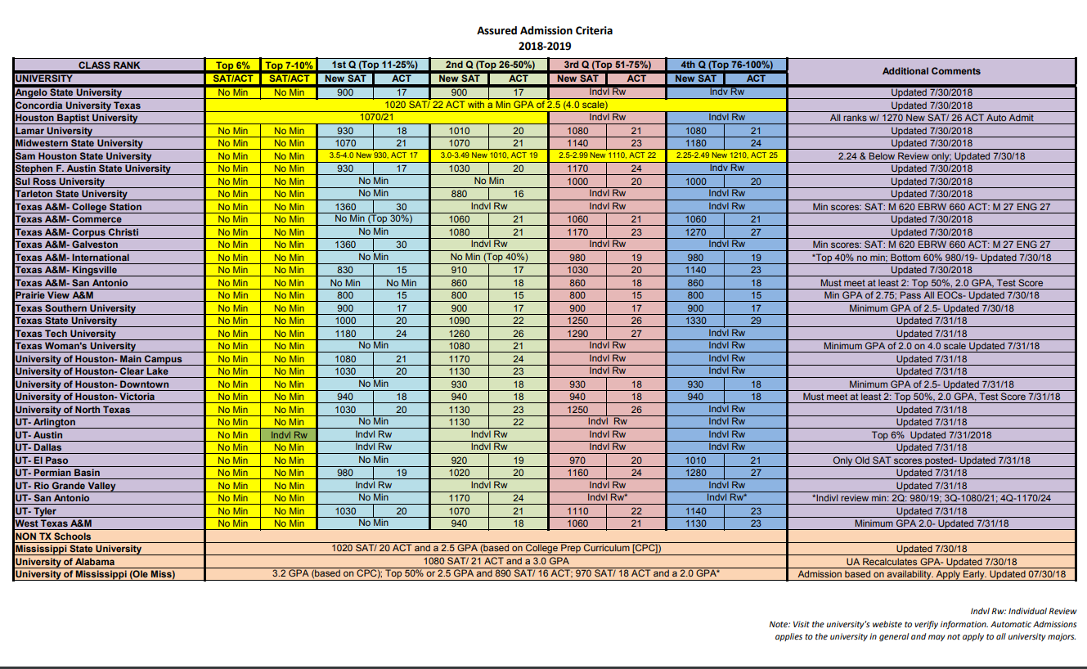
Notes:
CC

Slide 42
Notes:
CC

Slide 43
Online Testing Prep
[SAT PREP]
[ACT PREP]
[Practice Tests]
Notes:
CC

Slide 44
How Many Colleges Should I Apply To?
8 is the MAGIC NUMBER!
3 Safety Schools (I know I will get in)
Community College
Automatic Admissions Chart
3 Schools you hope to attend
Schools that do holistic review
1-2 Dream Schools!
Notes:
CC

Slide 45
FAST
Applying to College is FAST Fees Application Send Scores Transcript
Notes:
CC

Slide 46
FEES
Pay the application fee
(or submit a fee waiver if you are on free and reduced lunch. See your Counselor or Naviance)
Most community colleges, such as Houston Community College, do not charge an application fee.
The average cost of college applications is about $40.00, but some colleges charge $75.00 or more.

Slide 47
APPLICATION
State Schools:
applytexas.org (including junior colleges)
Private or Out of State:
commonapp.org Note: If using the common application, you must link your common app account to Naviance. See info on how to do this in the “How To” section in your handbook.
Applying through the University:
Students should be aware that they will not be able to copy an application this way. The only advantage students have in applying directly through the university is that sometimes a fee waiver is offered.
Notes:
CC

Slide 48
The College Essay
Personalize the application
Show who you are as a person vs. numbers
The closest you will come to introducing yourself to the admissions committee
Sets the tone for the rest of the application
Can demonstrate fit
Writing sample
No matter your intended major/career, ability to communicate effectively in writing is critical
Notes:
CC

Slide 49
SEND SCORES
Send SAT or ACT official scores to the colleges you are applying to.
If you have not taken one of these tests, sign up TODAY!
Junior colleges do not require the SAT or ACT, but they require a placement test called the TSI.
SAT sign up & testing dates: https://www.collegeboard.org/
ACT sign up & testing dates: www.actstudent.org
Notes:
CC

Slide 50
TRANSCRIPTS
Transcripts are sent to colleges in Naviance.
Students will login to Naviance using their FBISD user name & password.
Add the college you are applying to in “Colleges I’m Applying to.”
Once completed, the system will allow you to request a transcript. The registrar processes the transcript request, and the transcript is sent to the school within the week.
Notes:
CC

Slide 51
LETTERS OF RECOMMENDATION
Not every school requires letters of recommendation by a teacher or counselor. Research the school you are applying to before you request a letter. If you know you need a letter/ form, you should speak with/ email your counselor/ and or teacher at least three weeks before the deadline. (business days)
Notes:
CC

Slide 52
MANDATORY info you must provide:
-A resume that includes course work, GPA/ rank, community and extracurricular involvement.
-Submission deadlines for EACH institution you are applying to - List of Schools you are applying to & need a letter for (If this changes, and you choose to add a school or not apply to a school, contact the teacher and/ or counselor immediately as this affects your Naviance account) - The type of submission your letter requires (Which schools require this sent electronically? Which schools are you using the common application with? Which schools require the teacher/ counselor to mail the letter?)
Notes:
CC

Slide 53
Rec Letter Etiquette
Communicate often with your recommender.
Provide a resume & all the mandatory information requested.
Give at least 3 weeks notice for all letters.
Update teachers and counselors immediately as you add or remove colleges from your college app list.
Write a thank you note to the teacher/ counselor even if you’re not accepted to the university.
Notes:
CC

Slide 54
Rec Letter Etiquette
Be realistic in your goals. If you are really not interested in applying to a school, do not ask the counselor/teacher to write you a letter for that school. Quality letters of recommendation are time consuming for teachers and counselors.
Do not ask them unless you are serious about the school and can demonstrate, based on admission criteria, that this school is a realistic option.
Notes:
CC

Slide 55
MONEY
Cost: Go to the college website for cost information. Use a cost estimator to see what you might have to pay. FAFSA:
Apply for loans & grants starting October 1st using online form: FAFSA.ed.gov SCHOLARSHIPS: Apply for scholarships through your school, using search engines, and using the list in Naviance.
Follow the college & career twitter.
Notes:
CC

Slide 56
Notes:
CC

Slide 57
HARN College Fair ALL LUNCHES
Monday
March 18, 2018

